Slide 1
Data Communications

Slide 2
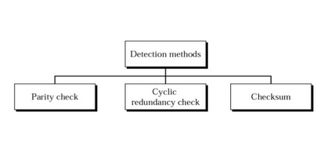
.

Slide 3
Parity Check
Append a parity bit to the end of a block of data.
For character transmission, a parity bit is attached to each 7-bit character.
The value of this bit is selected so that the character has an even number of 1s (even parity) or an odd number of 1s (odd parity).
.

Slide 4
Vertical Redundancy Check VRC
.

Slide 5
Find the parity bit (even parity) following data word
1010100
1100000
1101000
1001000
.

Slide 6
Check whether For the following codeword received gives parity failure or
Not (even parity).
10110110
10 101001
.

Slide 7
Vertical Redundancy Check VRC
It can detect single bit error
It can detect burst errors only if the total number of errors is odd.
If two (or any even number) of bits are inverted due to error, an undetected error occurs.
.

Slide 8
Longitudinal Redundancy Check LRC
.

Slide 9
Longitudinal Redundancy Check LRC
.

Slide 10
Longitudinal Redundancy Check LRC
LRC increases the likelihood of detecting burst errors.
If two bits in one data units are damaged and two bits in exactly the same positions in another data unit are also damaged, the LRC checker will not detect an error.
.

Slide 11
CHECKSUM
Error detection technique.
Used in network layer
.

Slide 12
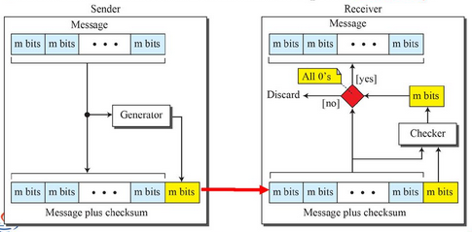
CHECKSUM
.

Slide 13
CHECKSUM
At the source the message is divided into m bit units.
Generator creates an extra m-bit (checksum), which is sent with the message.
At the destination, the checker creates a new checksum from the combination of the message and sent checksum.
If the new checksum is all 0s, the message is accepted; otherwise, the message is discarded.
.

Slide 14
CHECKSUM
Sending five 4-bit numbers to a destination.
In addition, we send the sum of the numbers.
if numbers are (7, 11, 12, 0, 6), then we send (7, 11, 12, 0, 6, 36).
Receiver adds the 5 numbers and compares the result with the sum.
.

Slide 15
CHECKSUM
To make the job of the receiver easier
Send the negative (complement) of the sum, called the checksum.
send (7, 11, 12, 0, 6, −36).
The receiver can add all the numbers received (including the checksum).
If the result is 0, it assumes no error; otherwise.
.

Slide 16
CHECKSUM
one’s complement arithmetic : we can represent unsigned numbers between 0 and 2^{m} – 1 using only m bits.
If the number has more than m bits, the extra leftmost bits need to be added to the m rightmost bits (wrapping)
.

Slide 17
CHECKSUM
Representing 21 in one’s complement arithmetic using only four bits
Solution
21 in binary is 10101 (it needs five bits).
wrap the leftmost bit and add it to the four rightmost bits.
(0101 + 1) = 0110 or 6.
.

Slide 18
CHECKSUM
Redoing previous example using one’s complement arithmetic.
Sender initializes the checksum to 0 and adds all data items and the checksum. The result is 36.
36 cannot be expressed in 4 bits.
Extra two bits are wrapped and added with the sum to create the wrapped sum value 6.
Sum is then complemented, resulting in the checksum value 9 (15 − 6 = 9).
Sender sends six data items to the receiver including the checksum 9.
.

Slide 19
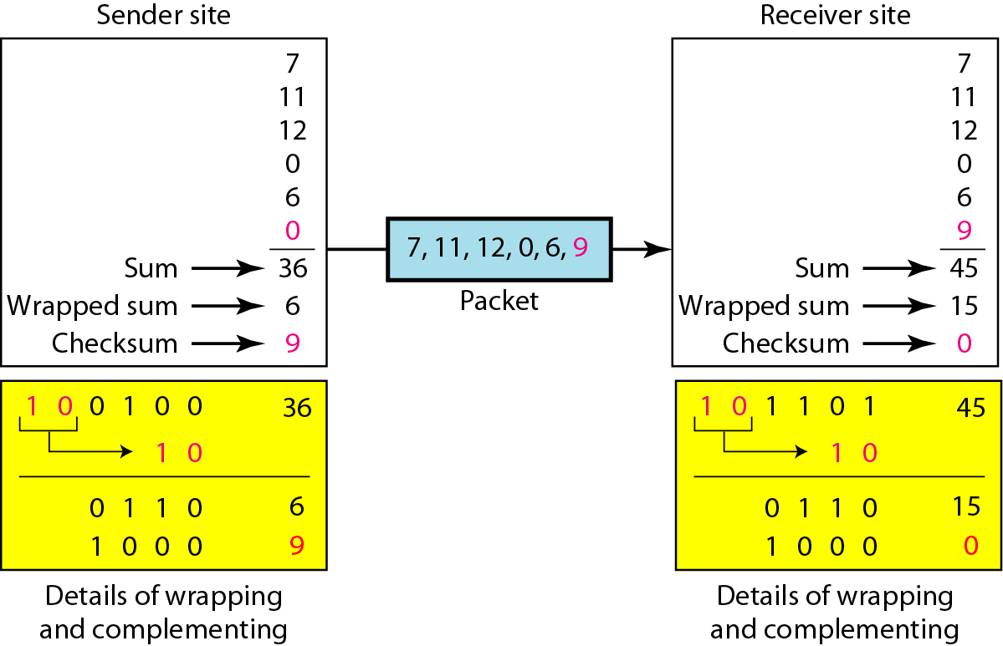
CHECKSUM
1 0 0 1
.

Slide 20
CHECKSUM
The receiver adds all data items (including the checksum); the result is 45.
The sum is wrapped and becomes 15.
The wrapped sum is complemented and becomes 0.
Since the value of the checksum is 0, this means that the data is not corrupted.
.

Slide 21
CHECKSUM
1 1 1 1
1 0 0 1
0 0 0 0
.

Slide 22
CHECKSUM
Sender
The message is divided into 16-bit words.
The value of the checksum word is set to 0.
All words including the checksum are added using one’s complement addition.
The sum is complemented and becomes the checksum.
The checksum is sent with the data.
.

Slide 23
CHECKSUM
Receiver
The message (including checksum) is divided into 16-bit words.
All words are added using one’s complement addition.
The sum is complemented and becomes the new checksum.
If the value of checksum is 0, the message is accepted; otherwise, it is rejected.
.

Slide 24
CHECKSUM
Example : checksum for a text of 8 characters (“Forouzan”).
The text needs to be divided into 2-byte (16-bit) words.
Example shows how the checksum is calculated at the sender and receiver sites.
If there is any corruption, the checksum recalculated by the receiver is not all 0s.
.

Slide 25
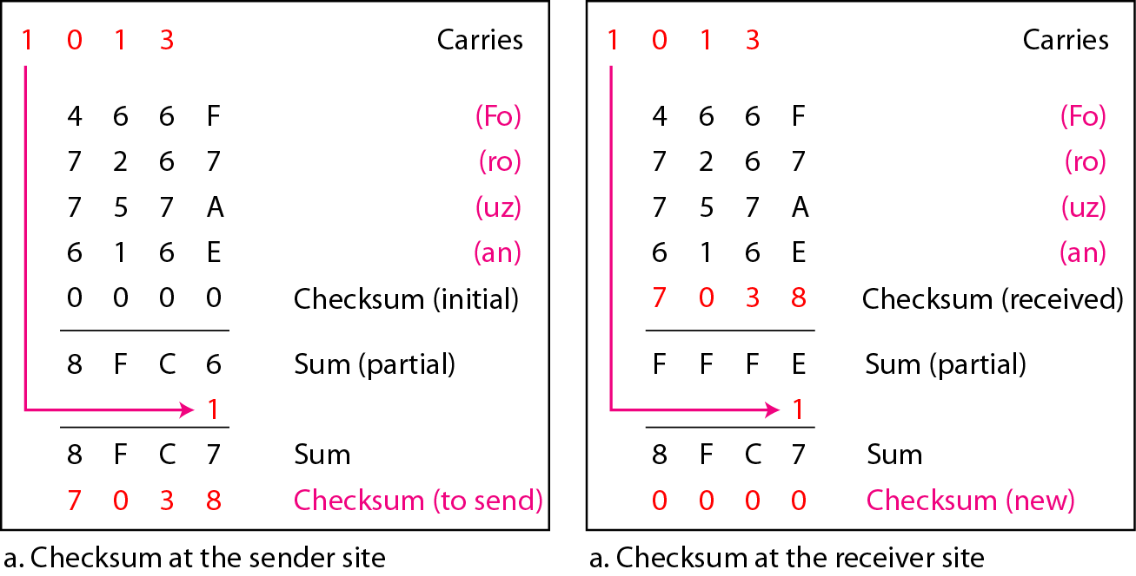
A – 65
a - 97
CHECKSUM
1 0 1 2
1 0 1 2
7 0 4 0
8 F B E
8 F B F
F F F F
7 0 4 0
.

Slide 26
A – 65
a - 97
CHECKSUM
1 0 1 2
1 0 1 2
7 0 4 0
8 F B E
8 F B F
F F F F
7 0 4 0
.

Slide 27
ERROR CORRECTION
Error detection is a useful technique, found in data link control protocols, such as HDLC, and in transport protocols, such as TCP.
Correction of errors using an error-detecting code, requires that block of data be retransmitted.
For wireless applications this approach is inadequate for two reasons.
The bit error rate on a wireless link can be quite high, which would result in a large number of retransmissions.
In some cases, especially satellite links, the propagation delay is very long.
.

Slide 28
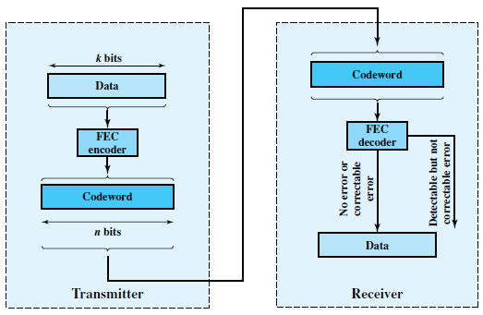
ERROR CORRECTION
Figure 6.7 Error Correction Process
.

Slide 29
ERROR CORRECTION
Block is passed through an FEC decoder, with one of four possible outcomes:
If there are no bit errors, the input to the FEC decoder is identical to the original codeword, and the decoder produces the original data block as output.
For certain error patterns, it is possible for the decoder to detect and correct those errors.
For certain error patterns, the decoder can detect but not correct the errors. In this case, the decode simply reports an uncorrectable error.
For certain, typically rare, error patterns, the decoder does not detect that any errors have occurred and maps the incoming n-bit data block into a k-bit block that differs from the original k-bit block.
.

Slide 30
ERROR CORRECTION
Error correction works by adding redundancy to the transmitted message.
The redundancy makes it possible for the receiver to deduce what the original message was.
.

Slide 31
ERROR CORRECTION
FEC algorithm takes as input a k-bit block and adds ( n – k ) check bits to that block to produce an n-bit block; all of the bits in the original k-bit block show up in the n-bit block.
For some FEC algorithms, the FEC algorithm maps the k-bit input into an n-bit codeword in such a way that the original k bits do not appear in the codeword.
.

Slide 32

Block Code Principles
Hamming distance d(v₁, v₂) between two n-bit binary sequences V₁ and V₂ is the number of bits in which V₁ and V₂ disagree.
For example, if
.

Slide 33
Block Code Principles
Find the hamming distance between
d(00000,00100) =
d(00111,00100) =
d(11001,00100) =
d(11110,00100) =
.

Slide 34
Block Code Principles
Consider a scenario to transmit blocks of data of length k bits.
Instead of transmitting each block as k bits, map each k-bit sequence into a unique n-bit codeword.
.

Slide 35
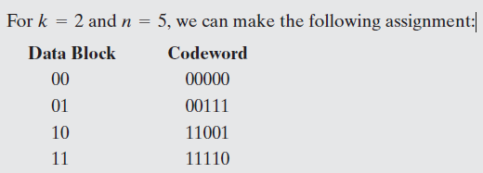
Block Code Principles
.

Slide 36
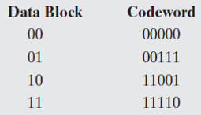
Block Code Principles
Suppose that a codeword block is received is 11001.
The corresponding dataword is 10
.

Slide 37
Block Code Principles
Suppose that a codeword block is received is 00100.
This is not a valid codeword, and so the receiver has detected an error.
We cannot be sure which data block was sent.
.

Slide 38
Block Code Principles
00100.
require a single bit change to transform 00000 into 00100.
require two bit changes to transform 00111 to 00100.
three bit changes to transform 11110 to 00100,
Require four bit changes to transform 11001 into 00100.
Thus, we can deduce that the most likely codeword that was sent was 00000 and that therefore the desired data block is 00. This is error correction.
.

Slide 39

Block Code Principles
00100.
In terms of Hamming distances, we have.
So the rule we would like to impose is that if an invalid codeword is received, then the valid codeword that is closest to it (minimum distance) is selected.
.

Slide 40
Block Code Principles
This will only work if there is a unique valid codeword at a minimum distance from each invalid codeword.
It is not true that for every invalid codeword there is one and only one valid codeword at a minimum distance.
There are 2⁵= 32 possible codewords of which 4 are valid, leaving 28 invalid codewords.
.

Slide 41
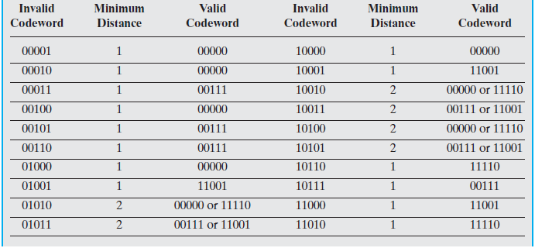
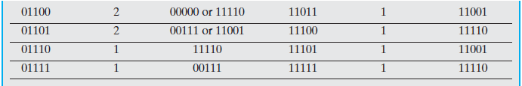
Block Code Principles
.

Slide 42
Block Code Principles
There are eight cases in which an invalid codeword is at a distance 2 from two different valid codewords.
Thus, if one such invalid codeword is received with 2 bits error, the receiver has no way to choose between the two alternatives.
An error is detected but cannot be corrected.
This code is therefore capable of correcting all single-bit errors but cannot correct double bit errors.
.

Slide 43

Block Code Principles
Pairwise distances between valid codewords:
The minimum distance between valid codewords is 3.
The code can always correct a single-bit error.
The code also will always detect a double-bit error.
.

Slide 44
Block Code Principles
The essential properties of a block error correcting code.
An (n, k) block code encodes k data bits into n-bit codewords.
Design of a block code is equivalent to the design of a function of the form
v_{c} = f(v_{d})
where v_{d} is a vector of k data bits and v_{c} is a vector of n codeword bits.
With an (n, k) block code, there are 2^{k} valid codewords out of a total of 2^{n} possible codewords.
.

Slide 45
Block Code Principles
Ratio of redundant bits to data bits, is called redundancy of the code.
The ratio of data bits to total bits, k/n, is called the code rate.
Code rate is a measure of how much additional bandwidth is required to carry data at the same data rate as without the code.
.

Slide 46
Block Code Principles
Prev example : Code rate of 2/5 and so requires 2.5 times the capacity of an uncoded system.
For example, if the data rate input to the encoder is 1 Mbps, then the output from the encoder must be at a rate of ________ Mbps to keep up.
.

Slide 47
Block Code Principles
Prev example : Code rate of 2/5 and so requires 2.5 times the capacity of an uncoded system.
For example, if the data rate input to the encoder is 1 Mbps, then the output from the encoder must be at a rate of 2.5 Mbps to keep up.
.

Slide 48

Block Code Principles
For a code consisting of the codewords w₁ w₂….w_{s} where s = 2^{n} the minimum distance d_{min} of the code is defined as
For a given positive integer t, if a code satisfies d_{min} >= (2t + 1) then the code can correct all bit errors up to and including errors of t bits.
If d_{min} >= 2t, then all errors < = ( t – 1) bits can be corrected and errors of t bits can be detected but not corrected.
.

Slide 49


Block Code Principles
Another way of putting the relationship between d_{min} and t .
The maximum number of guaranteed correctable errors per codeword satisfies
If we are concerned only with error detection and not error correction, then the number of errors, t, that can be detected satisfies
.

Slide 50
Block Code Principles
The design of a block code involves a number of considerations.
For given values of n and k, we would like the largest possible value of d_{min}
The code should be relatively easy to encode and decode, requiring minimal memory and processing time.
We would like the number of extra bits, (n – k), to be small.
We would like the number of extra bits, (n – k), to be large, to reduce error rate.
Clearly, the last two objectives are in conflict, and tradeoffs must be made.
.

Slide 51
Hamming Code
.

Slide 52

Hamming Code
Number of redundant bits
.

Slide 53
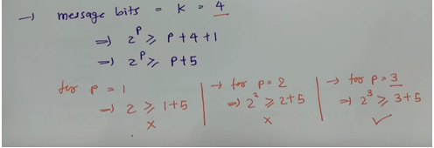
Hamming Code
Number of redundant bits
.

Slide 54
ERROR CORRECTION
Find additional bits required for the following
K=5
K=6
K=7
.

Slide 55
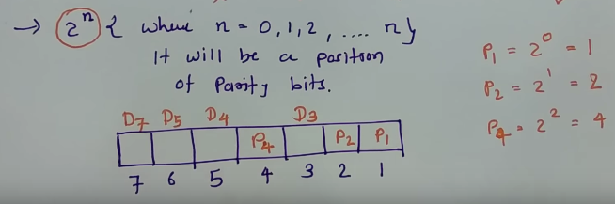
ERROR CORRECTION
Position of redundant bits
.

Slide 56
Hamming Code
.

Slide 57
Hamming Code
Find the additional bits required to send the following bits:
1001101
.

Slide 58
Hamming Code
.

Slide 59
Hamming Code
Find the hamming code for the following.
1011
.

Slide 60
Hamming Code
Single-bit error
.

Slide 61
Hamming Code
Error
Detection
.

Slide 62
END
.

